Slide 1
ROBO-GEEK ROBOTICS & STEM CLUB
Stem club project: driverless car
Robotics club project: iOt (Internet of Things)

Slide 2
project intro
By: Vanessa

Slide 3
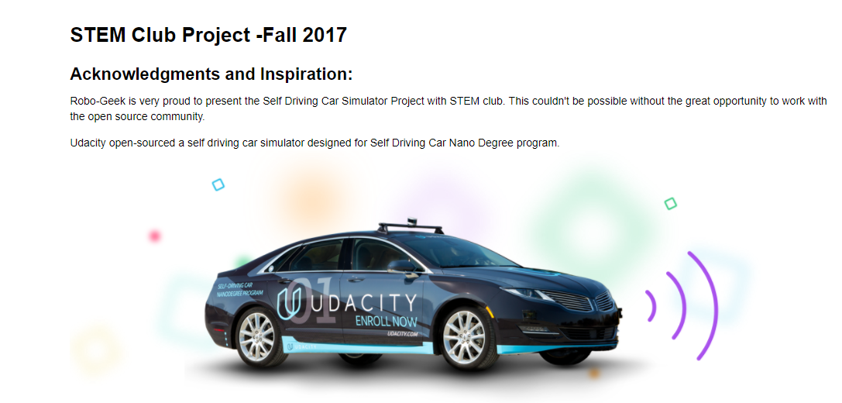

Slide 4
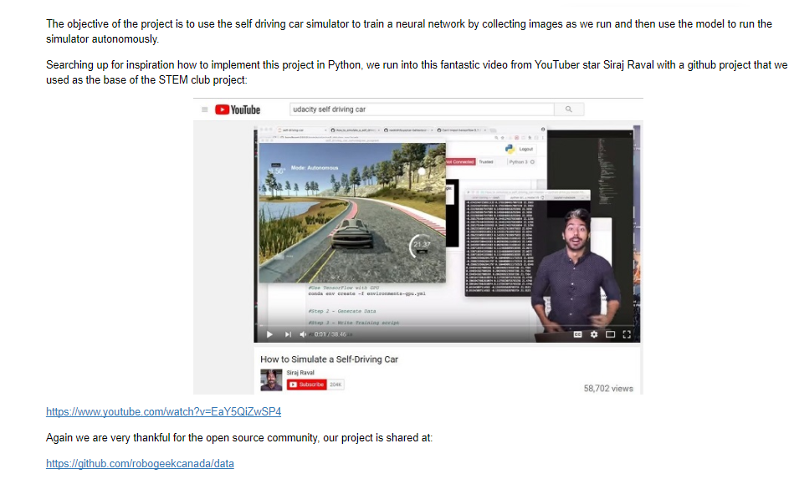

Slide 5
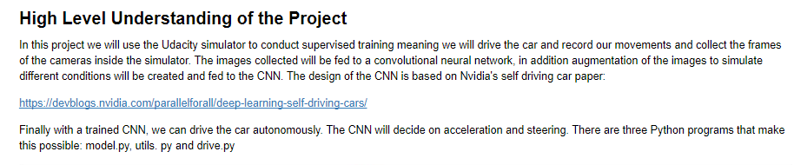
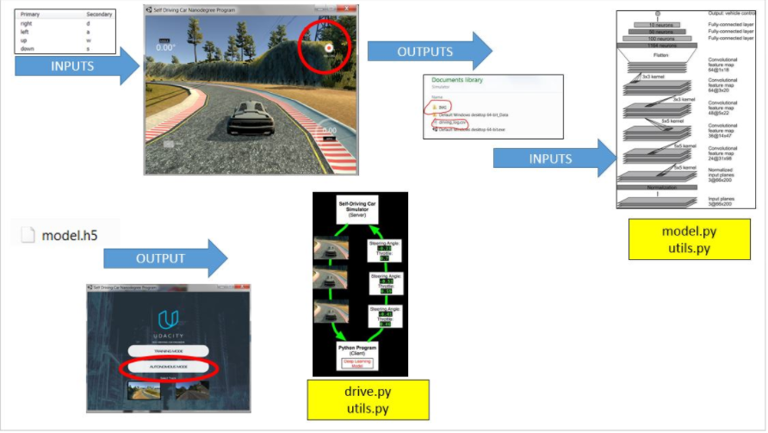
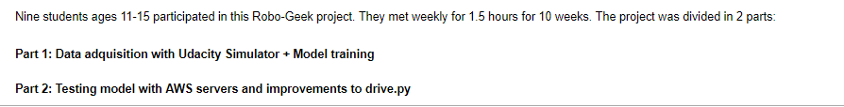

Slide 6
UDACITY SIMULATOR
By Liam & Raiden

Slide 7
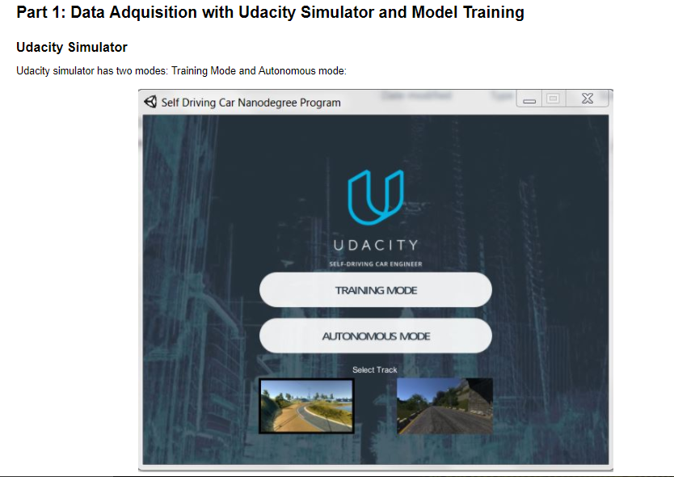

Slide 8
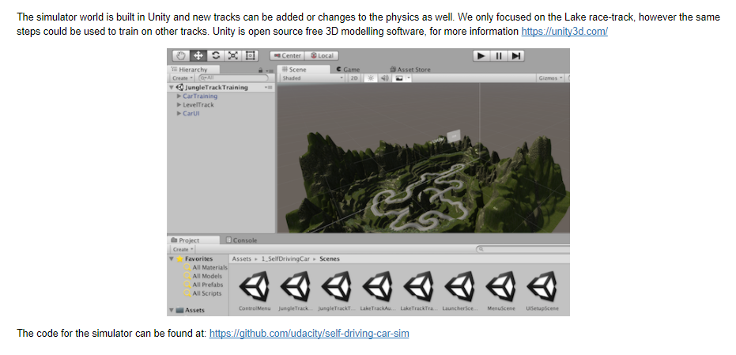

Slide 9
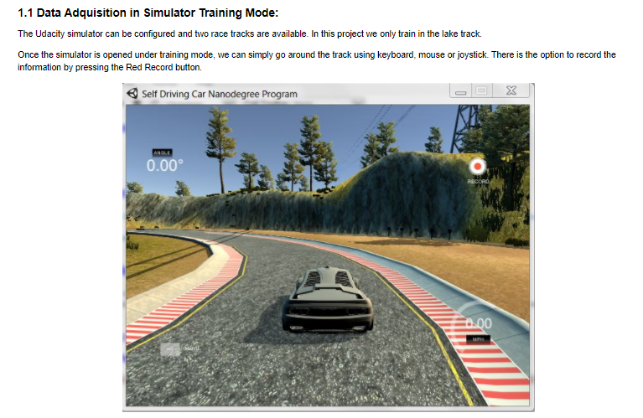

Slide 10
DEMO - SIMULATOR

Slide 11
PREPARING DATA FOR THE MODEL AND USING CONVULOTIONAL NEURAL NETWORK
By Duff & Joshua

Slide 12
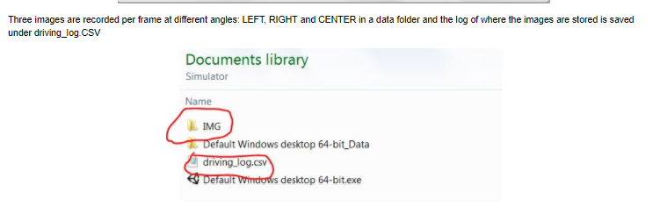
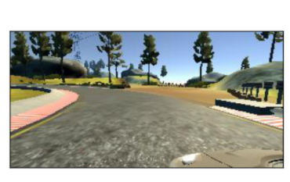
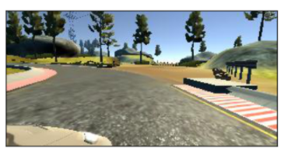
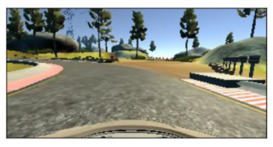
LEFT IMAGE
RIGHT IMAGE
CENTER IMAGE

Slide 13
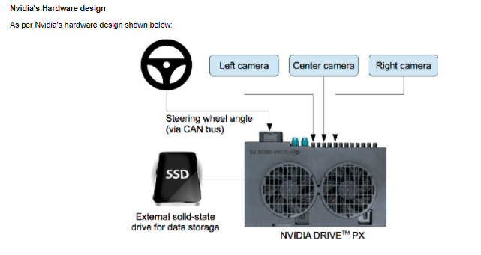
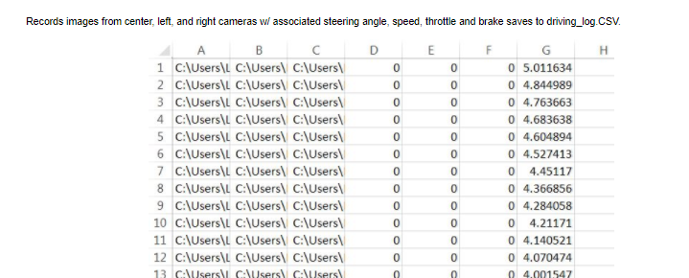

Slide 14
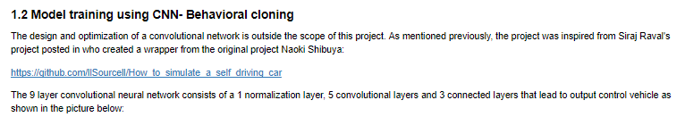
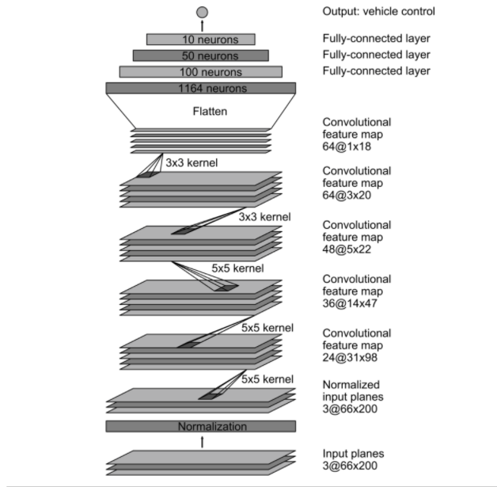

Slide 15
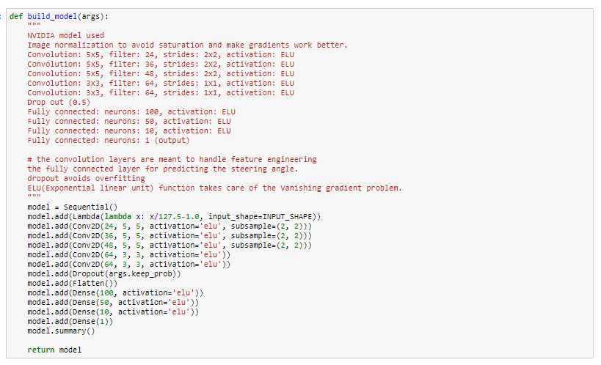

Slide 16
AMAZON AWS, USING CONDA
By Austin

Slide 17
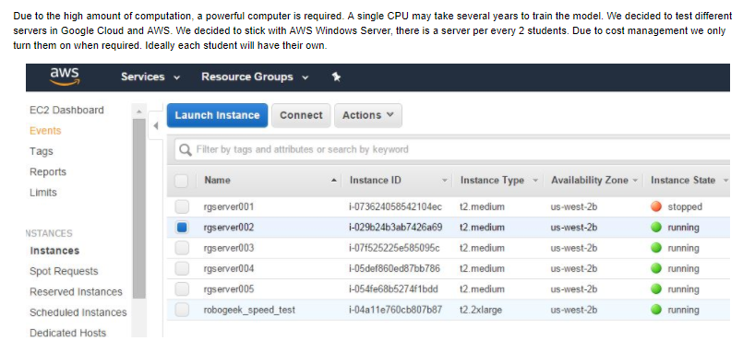

Slide 18
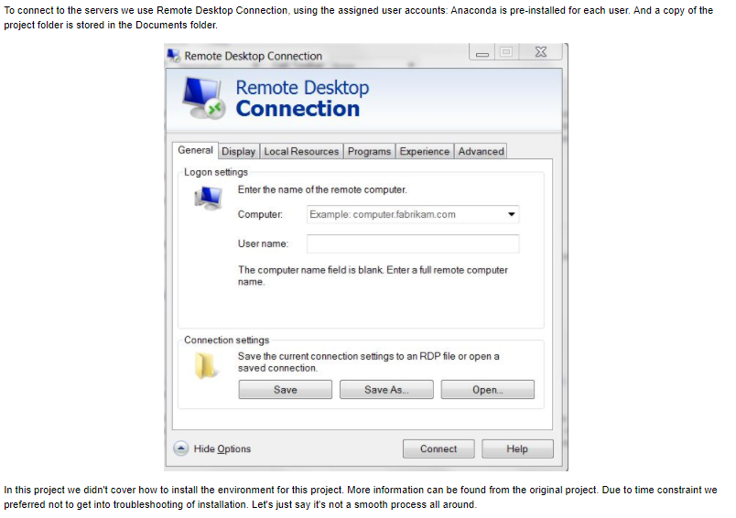

Slide 19
demo

Slide 20
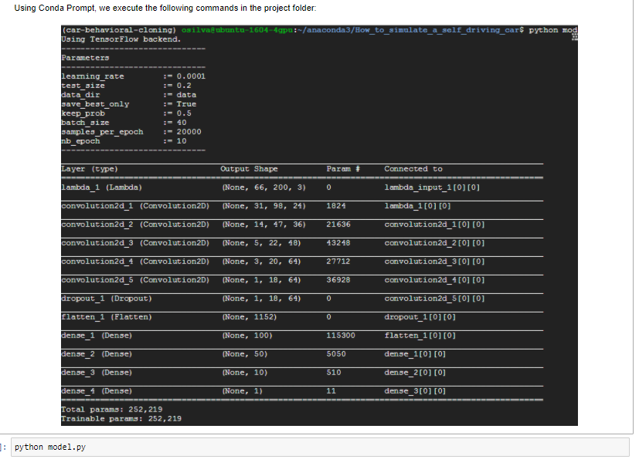

Slide 21
TRAINING THE MODEL
By PEDRO

Slide 22
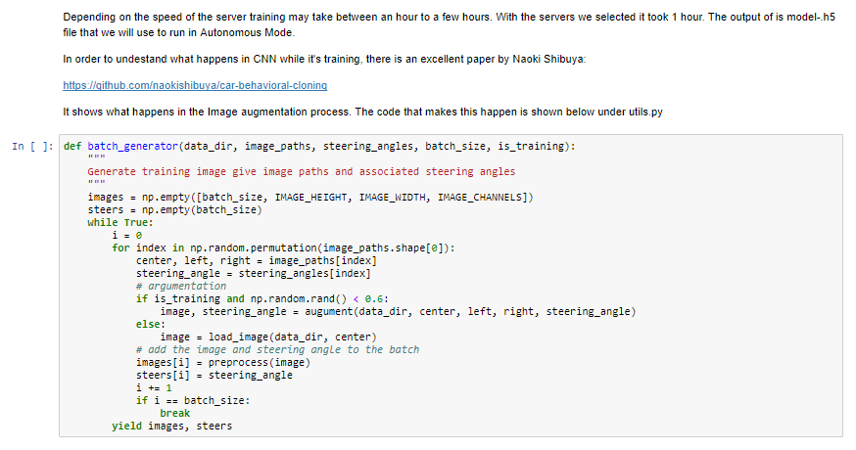

Slide 23
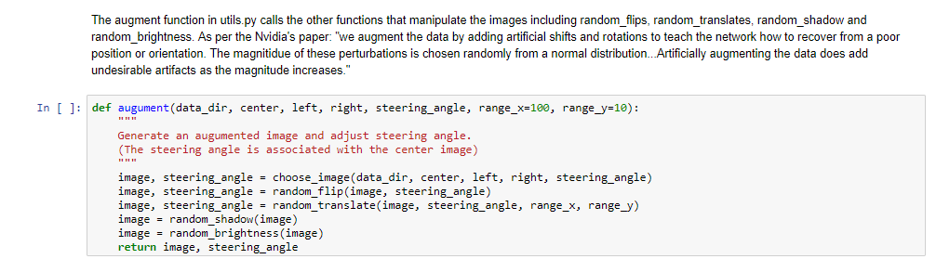
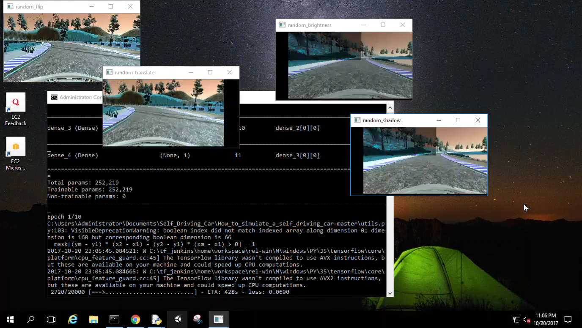

Slide 24
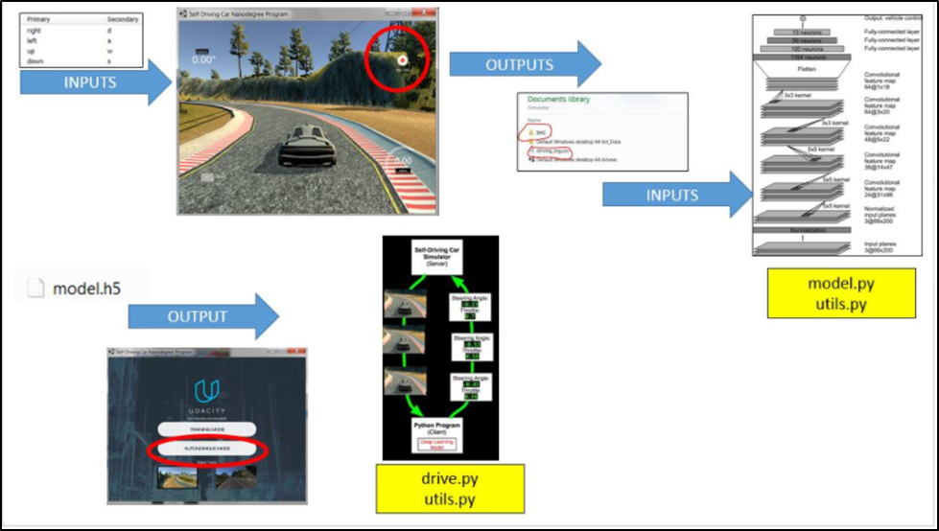
We trained the model recording 2 laps, each time we trained the network it took a couple hours to check the model. There were four models generated. The final model included data for 80 laps

Slide 25
TESTING MODEL
By Lorenzo

Slide 26
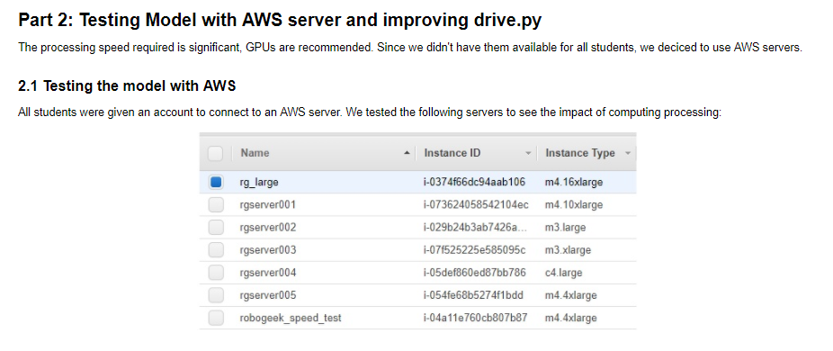

Slide 27
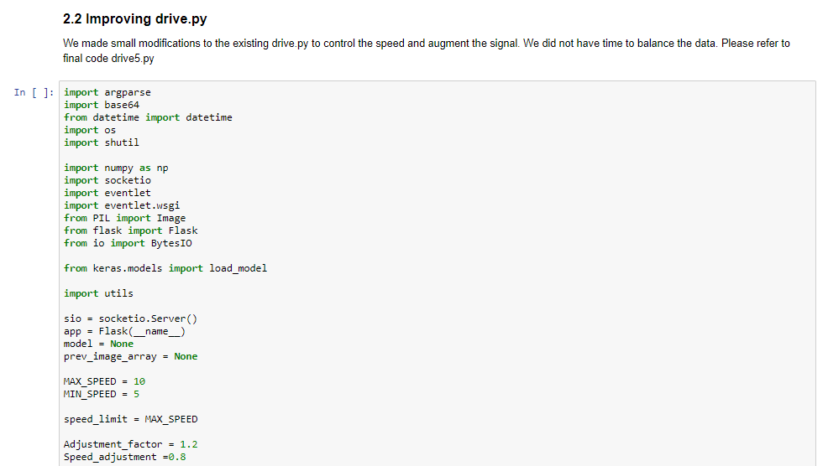

Slide 28
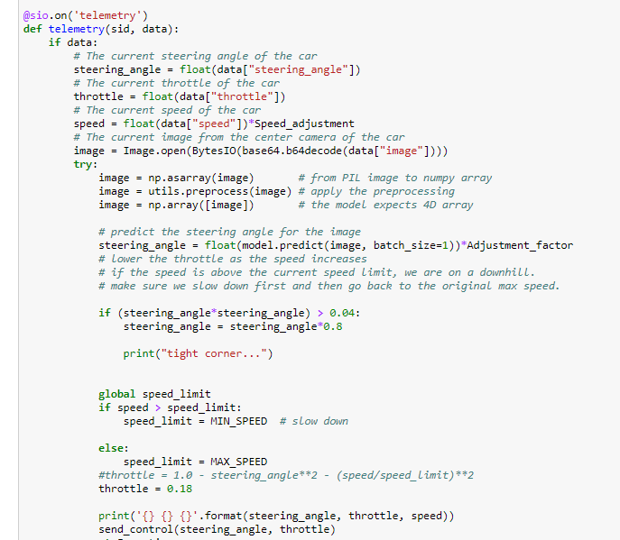

Slide 29
We experienced many difficulties and we adjusted the settings several times and the final version was drive5.py and model.h5

Slide 30
PUTTING IT ALL TOGETHER + DEMO
By GABRIEL

Slide 31
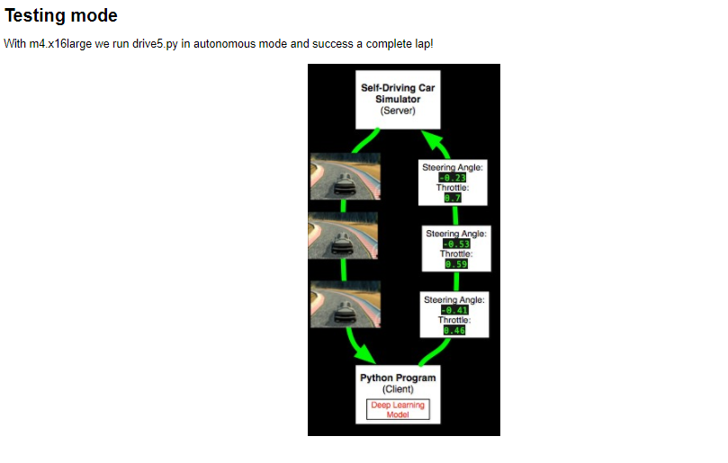

Slide 32
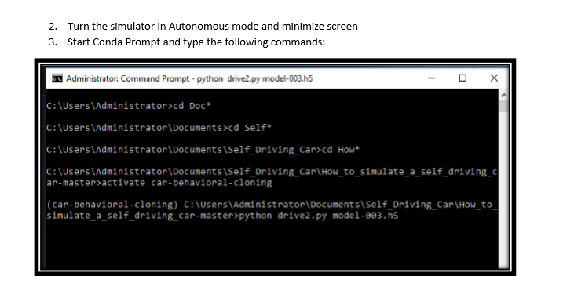

Slide 33
FINAL DEMO

Slide 34
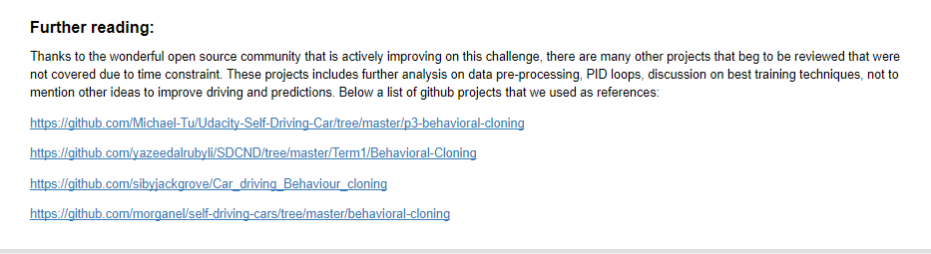
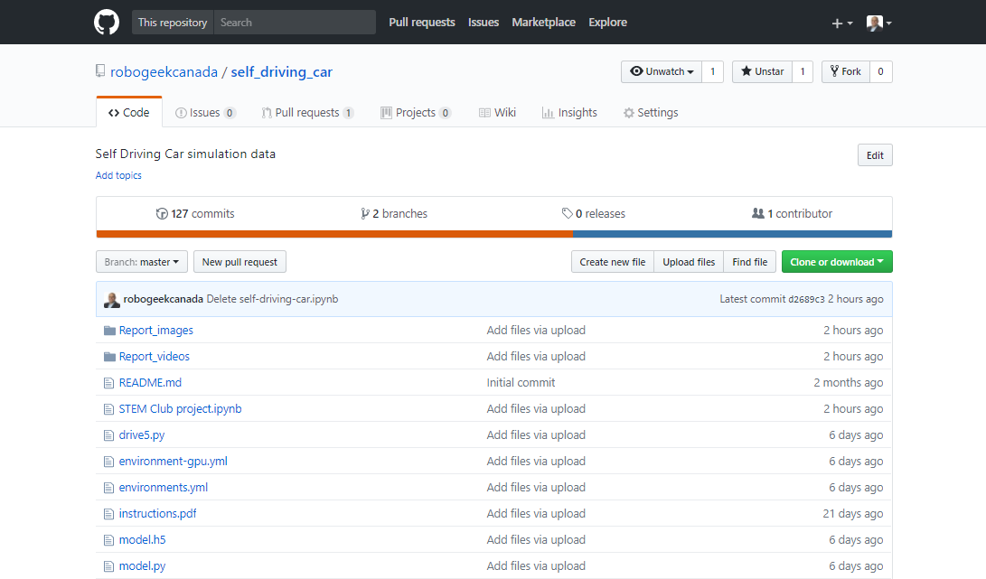

Slide 35
Thank you

